Slide 1

Welcome to PLACEMENT MANAGEMENT SYSTEM PPT

Slide 2


Presented by
1.SYEDA AZRA SIDDIQUA 2.RESHMA REVANKAR 3.PASUPUREDDYDEEPIKA 4.REKHA C Batch code-2021-6258
Center-Bangalore-S Prayas
Under The Training Co-ordinator
Anjana sarode
EDUBRIDGE.

Slide 3

INTRODUCTION
Placement Management System a student/company information system is a web based system.
It maintains a large database of students wherein all the information of student including the personal records and the academic performance.
The Placement Management System is developed as an attempt to take a record of company and student by restricting such a large database to that of a particular class of student or company.

Slide 4
Software Requirements:-
Front end: Java/J2EE technologies , HTML, CSS, JavaScript, Bootstrap, Hibernate.
Back end: MySQL workbench 8.0.23CE.
Middleware/Server: Apache Tomcat v8.5.
IDE: Spring Tool Suite4.0
Browser: Best result on Google Chrome
Operating System: Window 8 & 10.

Slide 5
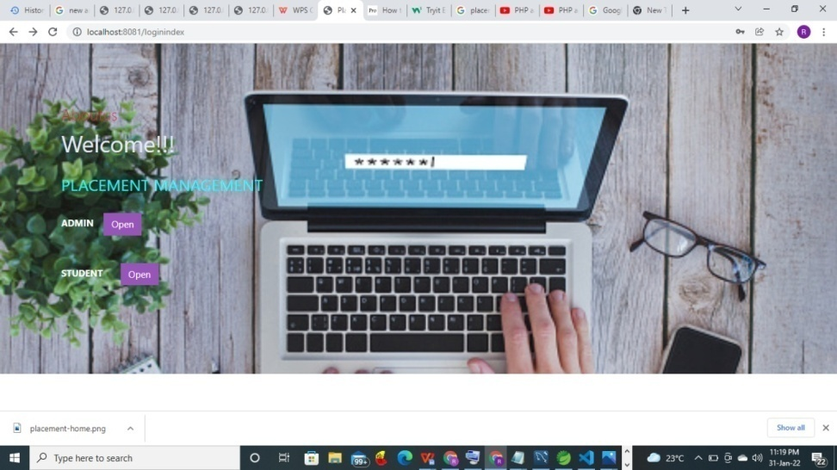
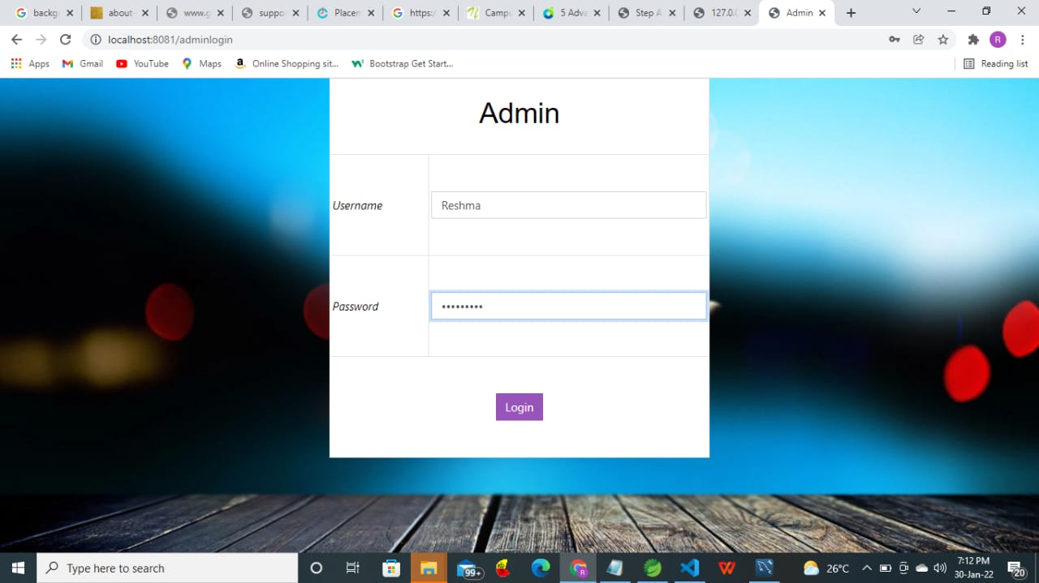
Output
Login Index
Admin Login

Slide 6
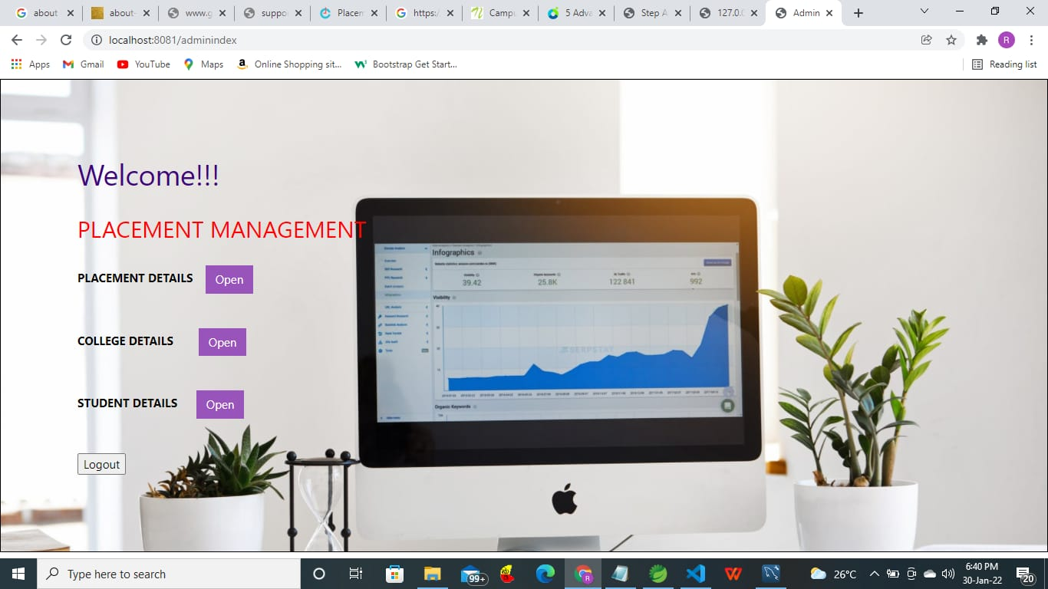
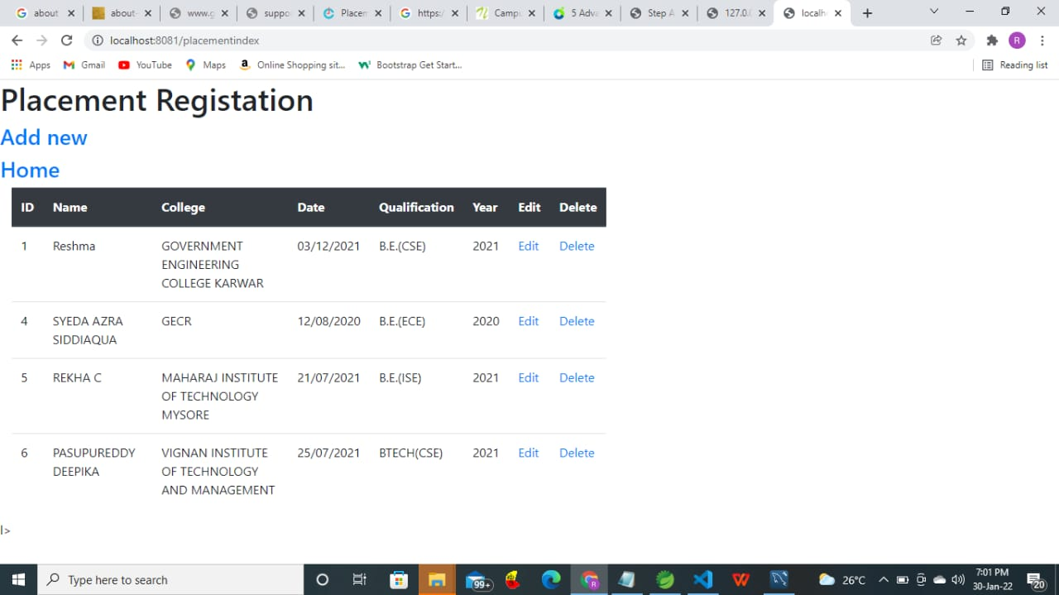
Output
Admin Index
Placement Index

Slide 7
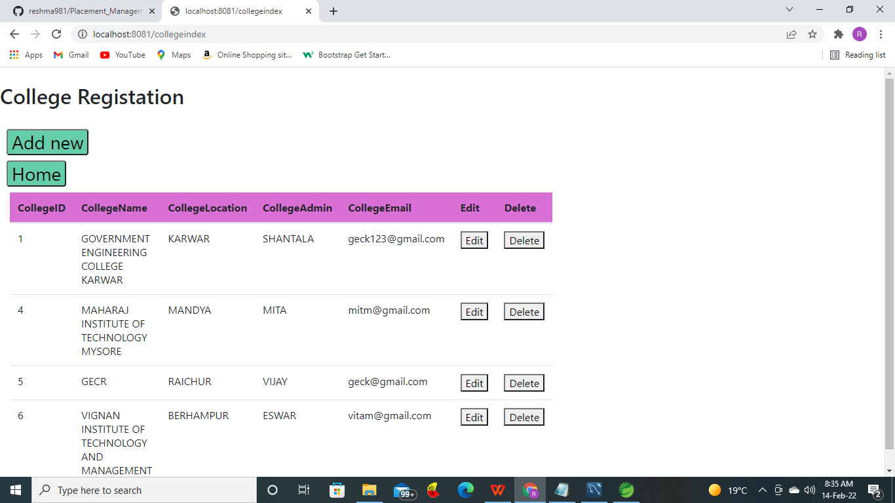
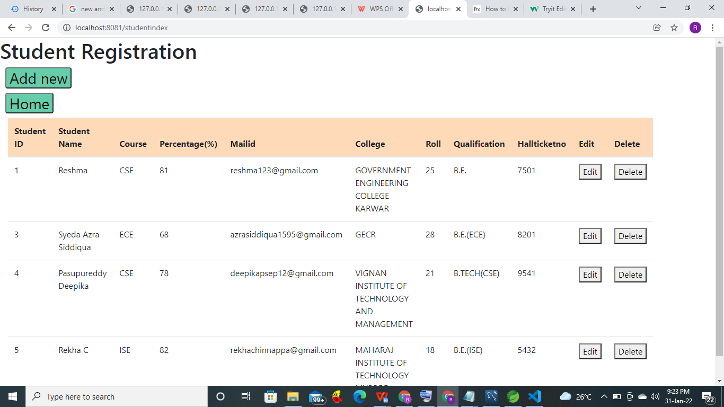
Output
College Index
Student Index

Slide 8
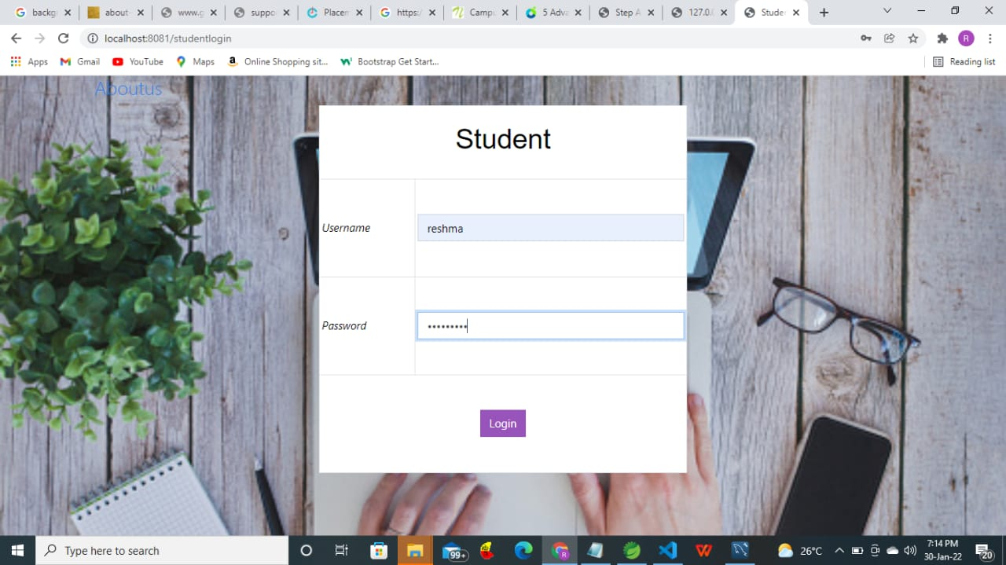

Output
Student Login
Student Tab

Slide 9
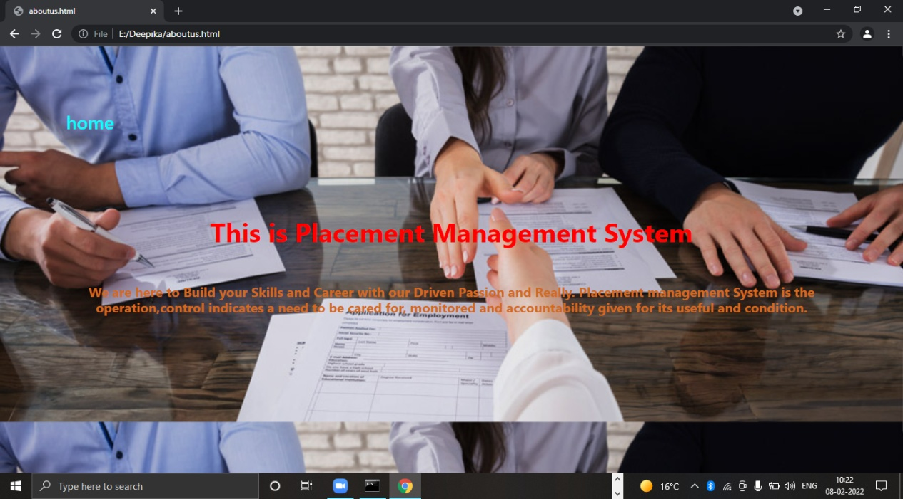
Output
Aboutus

Slide 10

THANK YOU

